Slide 1

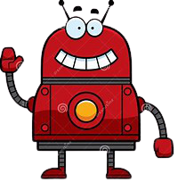

Many people have heard this, but nobody has ever seen it. It will never speak back until you speak to it. What is it?
It is black when you purchase it but becomes red when you use it, and then grey when you dispose of it. What is it?
My life can be measured in hours, I serve by being devoured. Thin, I am quick. Fat, I am slow. Wind is my foe. What am I?
1
2
I am not alive, but I grow; I don't have lungs, but I need air; I don't have a mouth, but water kills me. What am I?
4
3
Echo
Wind
Stones
Coal
Candle
Fire
Fire
Candle
Wrong!
Wrong!
Wrong!
Correct!
Wrong!
Correct!
Correct!
Correct!
I am white when I am dirty, and black when I am clean. What am I?
I am white when I am dirty, and black when I am clean. What am I?
This is as light as a feather, yet no man can hold it for long. What am I?
5
6
Three eyes have I, all in a row; when the red one opens, all freeze
What has to be broken before you can eat it?
7
8
Blackboard
Whiteboard
Air
Breathe
Onion
Traffic light
Bottle cap
Egg
Wrong!
Correct!
Wrong!
Correct!
Wrong!
Correct!
Wrong!
Correct!
Exit Game
Start Game

Slide 2
Objective
Find the Treasure in 2 minutes!
Click Here!
Loading
50%
10%
100%
20%

Slide 3

How many bones do shark have in their bodies?
What does the term “piano” mean?
Which email service is owned by Microsoft?
1
2
Which planet has the most gravity?
4
3
02
Minutes
Remaining
01
Minutes
Remaining
Time Over!
None
One
Play Loudly
Play Softly
Uranus
Jupiter
Hotmail
Outlook
Wrong!
Wrong!
Wrong!
Correct!
Wrong!
Correct!
Correct!
Correct!
Worldwide, which is the most commonly transplanted organ from living donors?
Which country’s flag features an eagle eating a snake?
5
6
What scientist challenged church dogma but was nevertheless buried in a Catholic cathedral in Formwork, Poland?
Who dedicated Atlas Shrugged to both her husband and her boyfriend??
7
8
Exit Game
Kidneywood
Stomach
Dominica
Mexico
Aristotle
Copernicus
Virginia Woolf
Ayn Rand
Wrong!
Correct!
Wrong!
Correct!
Wrong!
Correct!
Wrong!
Correct!
Oops!
Great !
Get Ready!

Slide 4
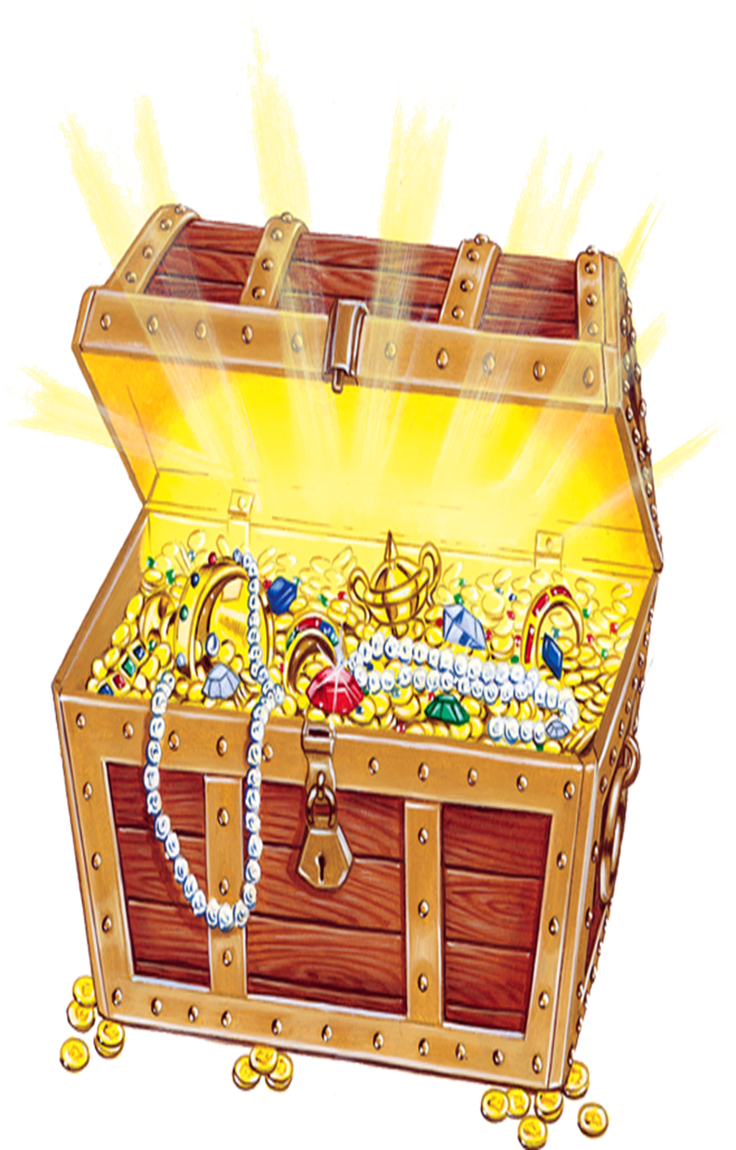
Exit Game!
Replay Game!
You Won!

